Slide 1
Numerical Methods
Introduction to Numerical Methods and Taylor Series

Slide 2
Lecture 2
Number Representation and Accuracy
Number Representation
Normalized Floating Point Representation
Significant Digits
Accuracy and Precision
Rounding and Chopping
Reading Assignment: Chapter 3

Slide 3
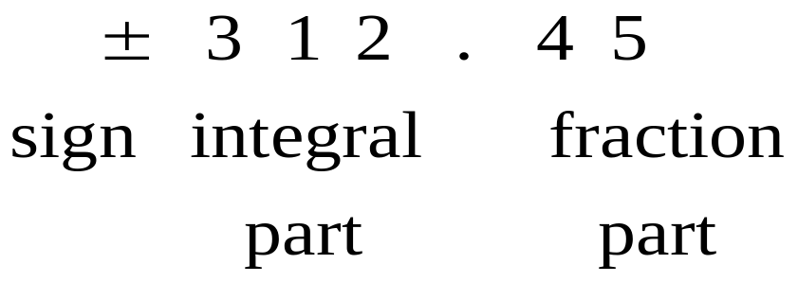
Representing Real Numbers
You are familiar with the decimal system:
Decimal System: Base = 10 , Digits (0,1,…,9)
Standard Representations:

Slide 4
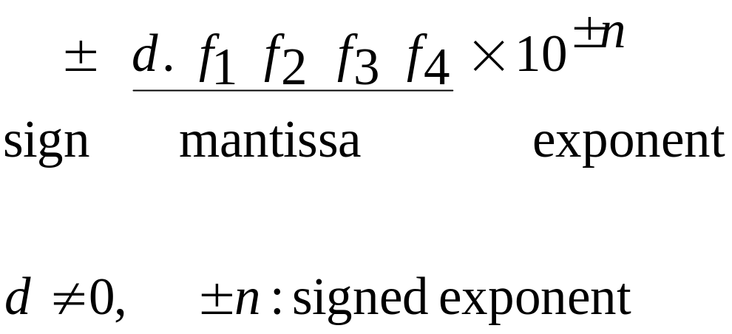
Normalized Floating Point Representation
Normalized Floating Point Representation:
Scientific Notation: Exactly one non-zero digit appears before decimal point.
Advantage: Efficient in representing very small or very large numbers.

Slide 5
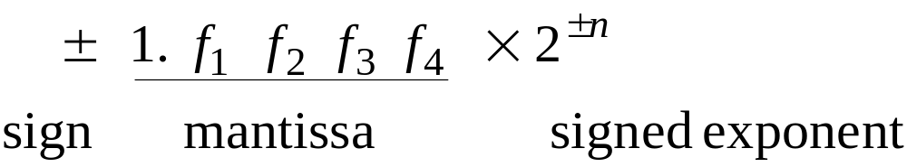
Binary System
Binary System: Base = 2, Digits {0,1}

Slide 6
Fact
Numbers that have a finite expansion in one numbering system may have an infinite expansion in another numbering system:
You can never represent 1.1 exactly in binary system.

Slide 7
IEEE 754 Floating-Point Standard
Single Precision (32-bit representation)
  1-bit Sign + 8-bit Exponent + 23-bit Fraction
Double Precision (64-bit representation)
  1-bit Sign + 11-bit Exponent + 52-bit Fraction
S
Exponent⁸
Fraction²³
S
Exponent¹¹
Fraction⁵²
(continued)

Slide 8
Significant Digits
Significant digits are those digits that can be used with confidence.
Single-Precision: 7 Significant Digits
  1.175494… × 10⁻³⁸ to 3.402823… × 10³⁸
Double-Precision: 15 Significant Digits
  2.2250738… × 10⁻³⁰⁸ to 1.7976931… × 10³⁰⁸

Slide 9
Calculator Example
Suppose you want to compute:
3.578 * 2.139
using a calculator with two-digit fractions
3.57
*
2.13
=
7.60
True answer:
7.653342

Slide 10
Accuracy and Precision
Accuracy is related to the closeness to the true value.
Precision is related to the closeness to other estimated values.

Slide 11
Rounding and Chopping
Rounding: Replace the number by the nearest
machine number.
Truncation or Chopping: Throw all extra digits.

Slide 12
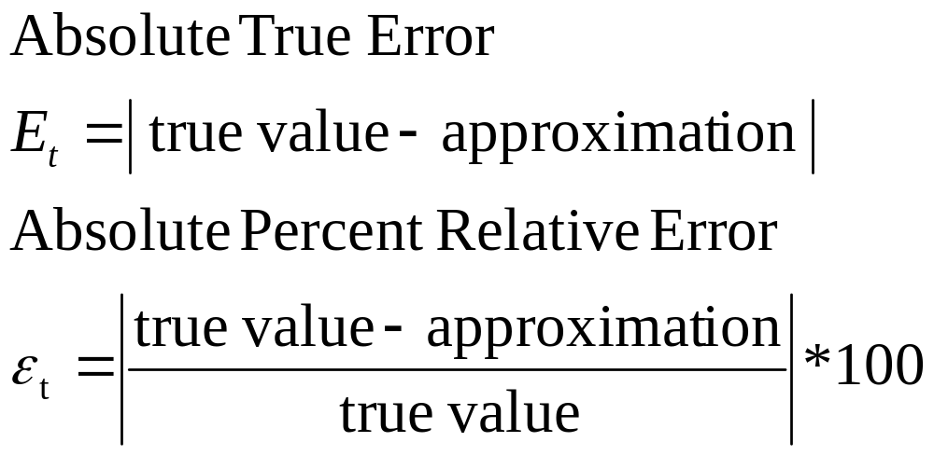
Error Definitions – True Error
Can be computed if the true value is known:

Slide 13
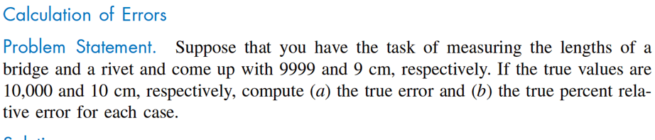
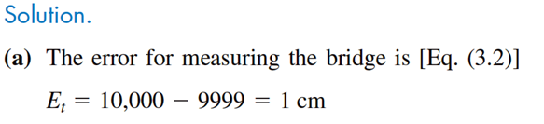
Error Definitions – True Error

Slide 14
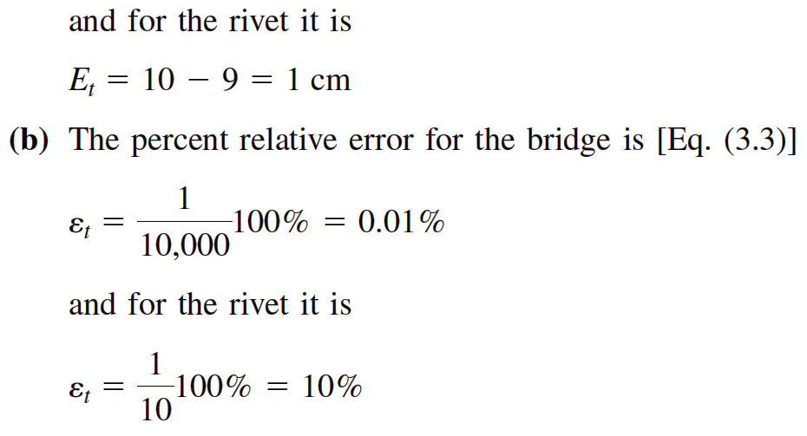
Error Definitions – True Error

Slide 15
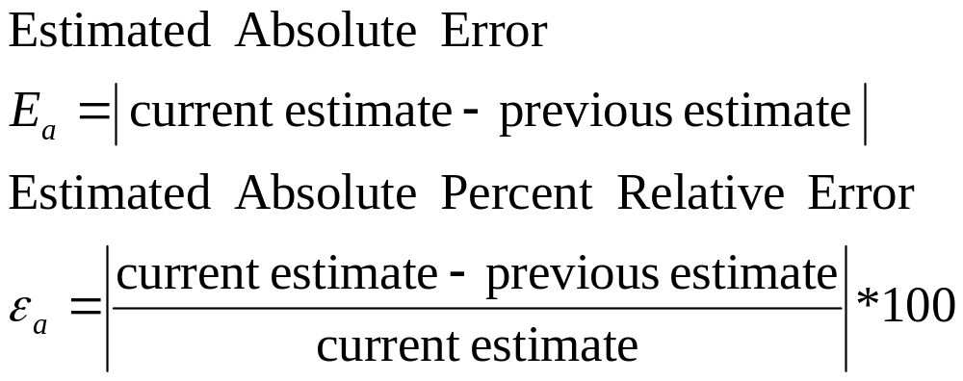
Error Definitions – Estimated Error
When the true value is not known:

Slide 16
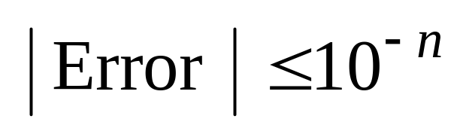
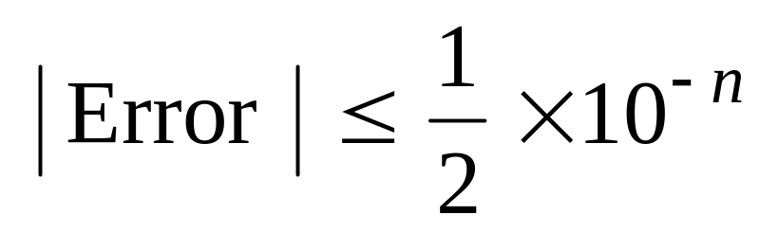
Notation
We say that the estimate is correct to n decimal digits if:
We say that the estimate is correct to n decimal digits rounded if:

Slide 17
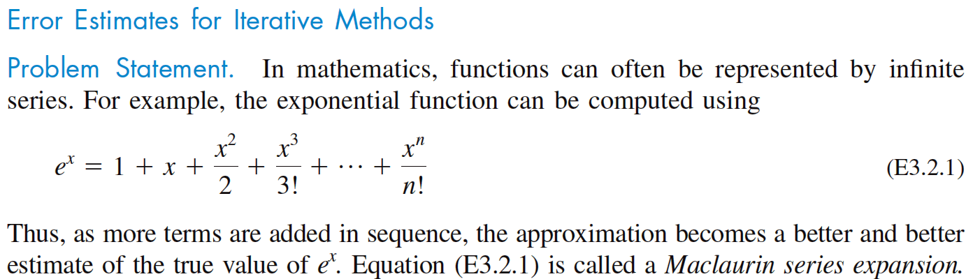
Maclaurin Series: Approximate Error

Slide 18
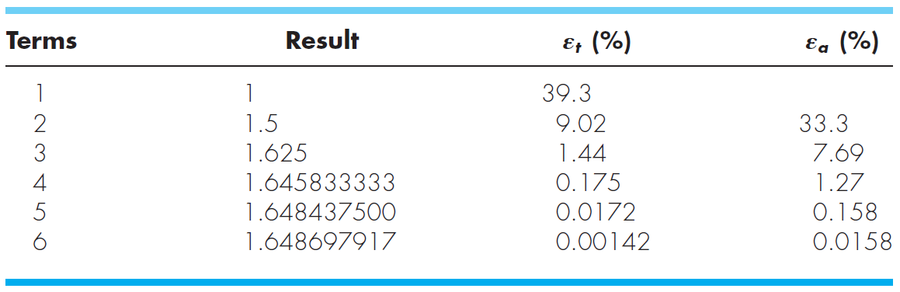
Maclaurin Series: Approximate Error
Estimate e^{0.5} using Maclaurin series. Assume true value is 1.648721

Slide 19
Summary
Number Representation
Numbers that have a finite expansion in one numbering system may have an infinite expansion in another numbering system.
Normalized Floating Point Representation
  Efficient in representing very small or very large numbers,
  Difference between machine numbers is not uniform,
  Representation error depends on the number of bits used in the mantissa.

